Slide 1
Teamcenter Integration for SolidWorks
What’s New in version 9.2.0?

Slide 2
Roadmap feature summary
Usability
Update by revision rule
Family table management
Configuration “keep” preference
Auto-assign configuration-specific item IDs
Customer Response
ER6733696: Remove Add Configurations button
Delete auxiliary files after save
Different icons for new and modified
Bi-directional family table relations
ER6569525: Advanced search sort order
ER6567269: Remove default search panel
ER6698824: Synchronize item name with description
ER6837512: Add project to user settings
Thumbnail images in save dialog

Slide 3
Version support
Teamcenter
Tc9.1+
Tc8.3+
SolidWorks
SW2011
SP0+
SW2012
SP0+
SW2013
SP1+

Slide 4
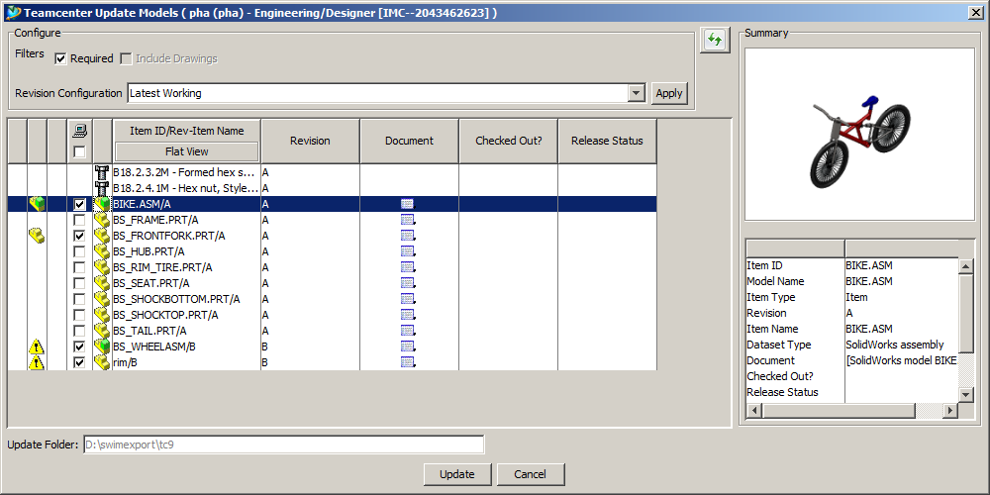

Usability – Update by revision rule
Configurable update in session
Preserves “one-step” update to new versions
When the user wants to retain the original configuration of his assembly, while updating to newer versions within that configuration
Simplifies and streamlines updating to newer (or older) revisions, based on the default or the selected revision rule
Typical scenario is when an assembly is opened with latest working. After some time newer working revisions of several components are created by other users. Now you can update to those later revisions without selecting them individually.
Revision B of these parts is now automatically selected because they are the latest working – in most cases the user will only have to press the OK button to “update all latest”

Slide 5
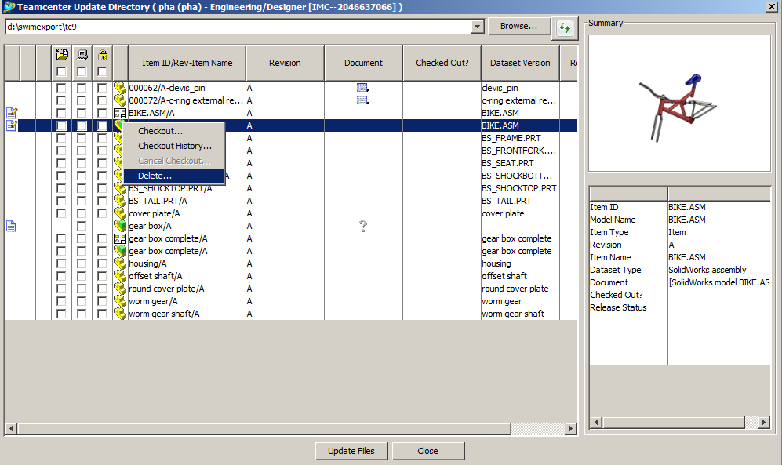
Usability – Delete auxiliary files after save
Automatic cleanup of working directory
Deletes derived data such as JT, PNG, PDF, etc.
This helps manage the size of the working directory, and can also prevent “stale” auxiliary files from being saved to new versions or revisions
Use this new capability to persuade CAD designers that they don’t have to manage their CAD data outside of Teamcenter – they should always use Update Directory instead

Slide 6
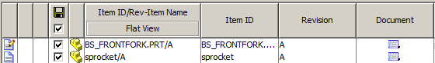
Usability – Different icons for new and modified
To help users make better decisions about what to save
Means this is a brand-new model being saved for the first time, or it is a new revision of an existing model
Means this revision already exists in Teamcenter, and has been modified in SolidWorks

Slide 7
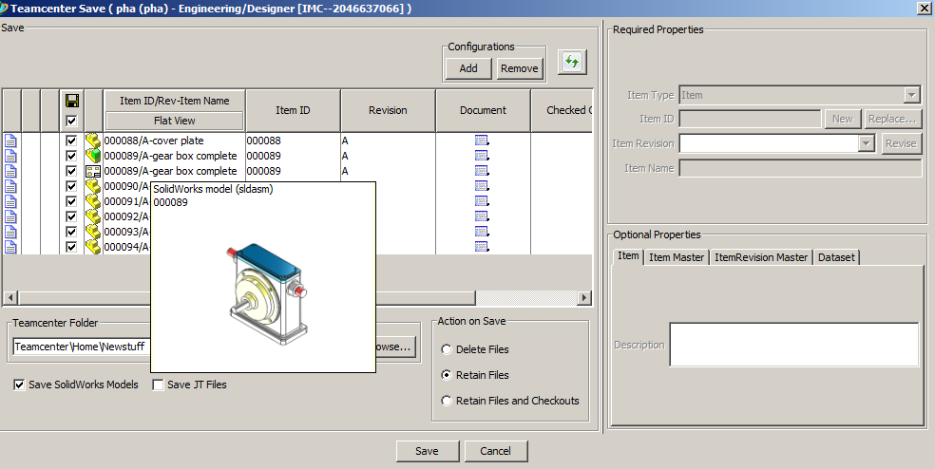
Usability – Thumbnail images in save dialog
Shows the user what he is saving
This is particularly useful when the customer has followed our recommendation to derive CAD model names from assigned item IDs – in that case the model names will not reflect any design intent. The thumbnail image will remind the user of what the CAD models look like, which might be important when assigning item types or other attribute information.
If a model has never been saved to disk, there will be no preview image
The preview image is generated only for the active configuration, which may not match the configuration actually being saved to Teamcenter
The thumbnail is displayed when the user hovers his mouse over a row in the table

Slide 8
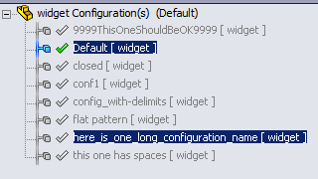
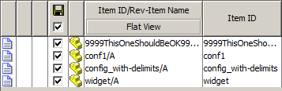
Family table management – Configuration keep preference
More control over which configurations are managed by Teamcenter
Previously we could only tell the integration which configurations to ignore, by name
Some customers have more configurations to ignore than to keep, and the ignored configurations may not have a consistent naming convention
Combined with the pre-existing hide preference, this option provides flexibility in controlling which configurations are managed.
The hide preference will hide configurations named flat pattern, open or closed, even though all would be allowed by the keep preference. The keep preference will subtract configurations with spaces, special characters, or whose names exceed 28 characters (to prevent a problem with JT import into Pro/ENGINEER, for example)

Slide 9
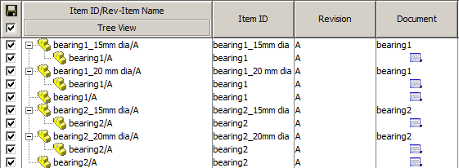
Family table management – Auto-assign configuration-specific Item IDs
Naming association between configurations and master documents.
Configuration item IDs are automatically assigned as {document_name}_{configuration_name}
First time save & import only – if item IDs are changed later, naming association will be lost
Precludes the use of assigned item IDs
May simplify saving and searching for some customers – when there are many same-named configurations which must be managed as items in Teamcenter.

Slide 10
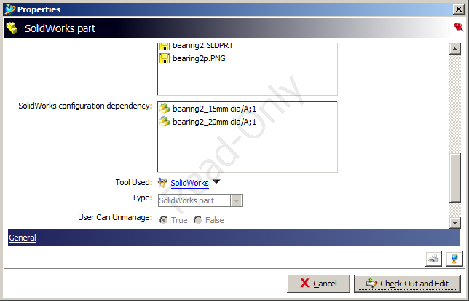
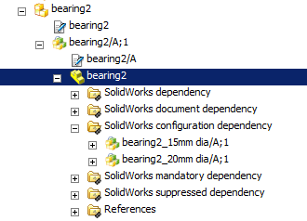
Family table management – Bi-directional family table relations
Links master documents to their configurations
Supports programmatic traversal of family table relations
Multisite transfer – transfer all family table members along with the master. This is needed to prevent duplication of item IDs across sites
Release workflows – release all members with the master
Navigation from document to configurations in the RAC
To visually identify and operate on all configurations belonging to a selected document revision

Slide 11
Family table management – Bi-directional family table relations
swim_upgrade_database.exe
Utility program to add the new SW2_configuration relation to all family table members
This program should be run at all sites immediately after updating to SWiM 9.2.0, and before any more data is transferred between sites
swim_upgrade_database -u=infodba -p=infodba -g=dba -mode=FULL –dryrun –log=.\swim_upgrade_database_dryrun.log
To generate a report of relations to be created
swim_upgrade_database -u=infodba -p=infodba -g=dba -mode=FULL –log=.\swim_upgrade_database.log
To actually perform the update

Slide 12
Family table management – Bi-directional family table relations
swim_upgrade_database.exe
After the SW2_configuration relations are created, you must add the SW2_configuration relation type to any configuration point in Teamcenter where family table relations should be traversed
Likely candidates are the MultiSite transfer dialog & preferences, and workflow handlers

Slide 13
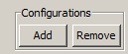
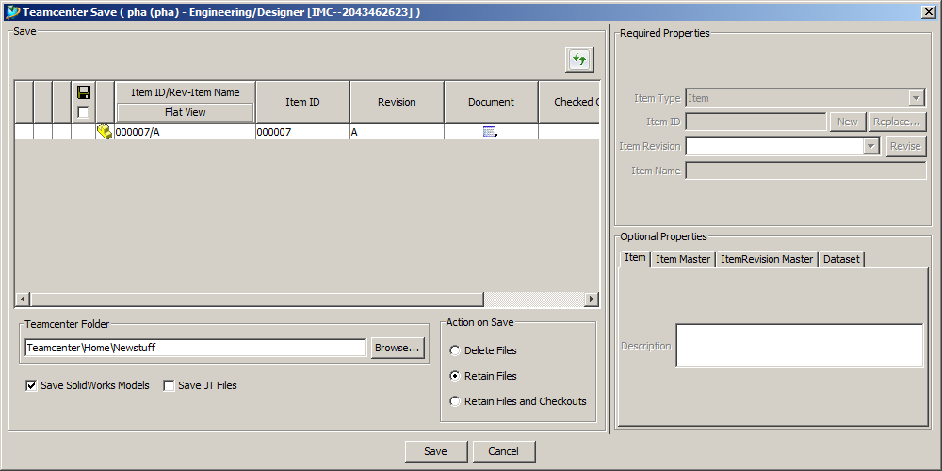
Customer Response
ER6733696: Remove Add Configurations button
Preference to hide Add Configurations button on the save and import dialogs
Desired by customers who never want to manage configurations items
Save dialog with sw.configurations.addbutton = false

Slide 14
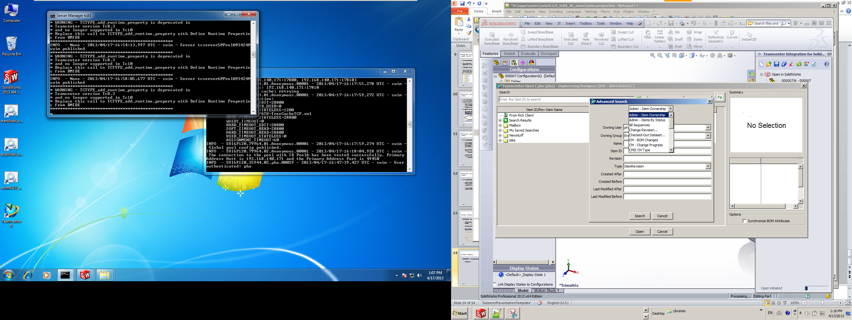
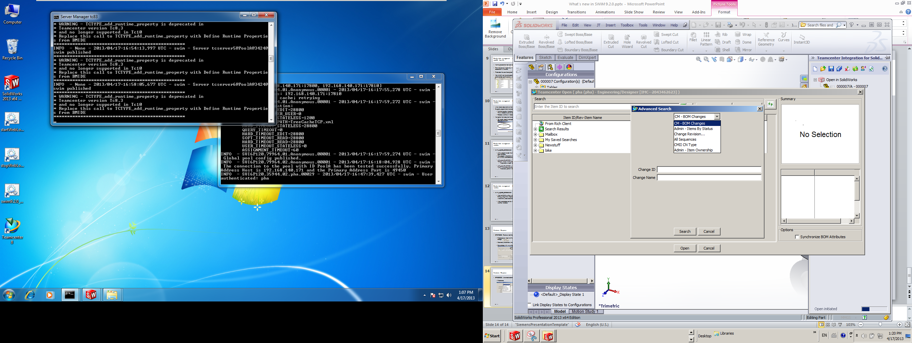
Customer Response
ER6569525: Advanced search sort order
The iman.queries.allowed now controls ordering of searches, as well as allowed searches
iman.queries.allowed set to CM – BOM Changes:Admin – Items By Status:Change Revision…:All Sequences:CMII CN Type:Admin – Item Ownership
iman.queries.allowed not set

Slide 15
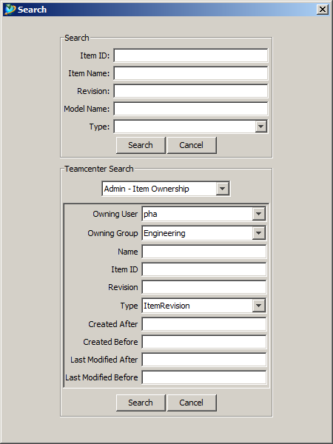
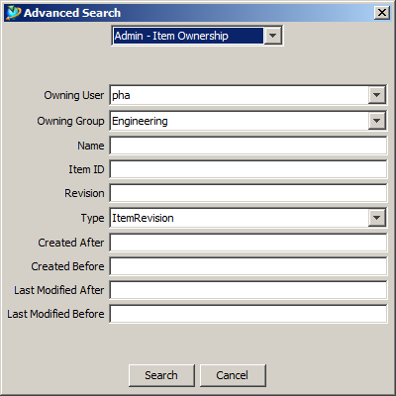
Customer Response
ER6567269: Remove default search panel
Customer request was to only remove the intermediate search panel on the Advanced Search dialog, since all of its capabilities were available from the advanced panel already, and users found the redundancy confusing

Slide 16
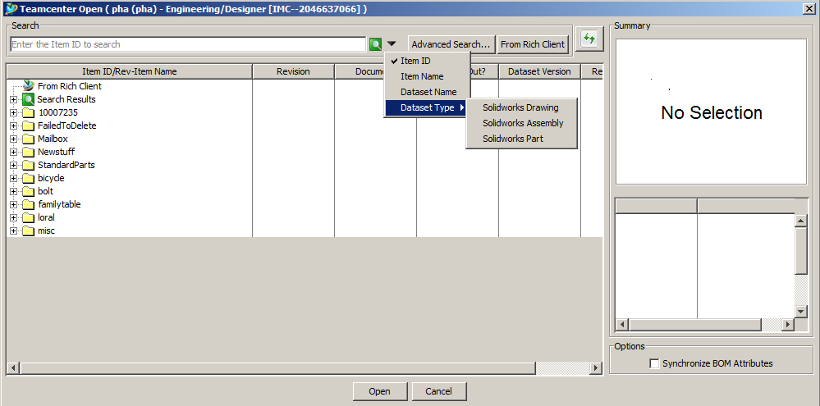
Customer Response
We decided to further improve usability by making the simple search on the Open dialog much more flexible and aligned with the Teamcenter Rich Client. Now you can search by any one of four criteria, without using the Advanced Search

Slide 17
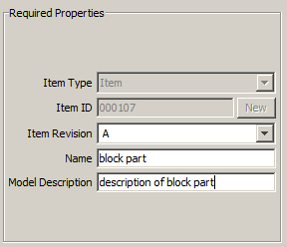
Customer Response
ER6698824: Synchronize item name with description
Resolves inconsistencies in item name, for example . . .
The user creates a part and assigns a Description which is different from the item name
He then makes a drawing for the part, with a Description that is different from the part’s description

Slide 18
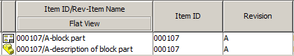
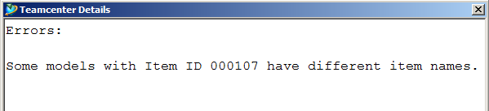
Customer Response
At this point there are three different values feeding item name
block part – this is the current name of the item already created in Teamcenter
description of block part – this is mapped from the Description property of the part
drawing of block part – this is mapped from the Description property of the drawing, which is being saved to the same item ID as the part
The result is a conflict in the save dialog
The user must manually resolve this conflict before continuing

Slide 19
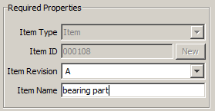
Customer Response
In 9.2.0, the same scenario goes like this . . .
When the user creates the part, the assigned item name is automatically written into the Description property in the CAD model

Slide 20
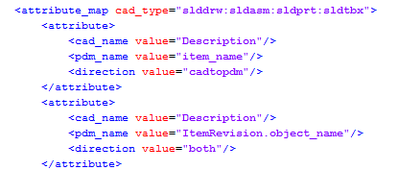
Customer Response
When he creates the drawing and gives it a different description, the integration ignores the drawing description and overrides it with the part’s item name, in the save dialog
Part of this enhancement is enabled by the updated default attribute mapping in the swim.xml file, so this mapping should be loaded and retained by all customers

Slide 21
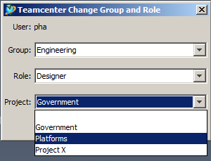
Customer Response
ER6837512: Add project to user settings
Customers working with project security, or A&D programs, must be able to change their active project without exiting and restarting their CAD sessions
In the A&D environment, the dialog still says Project and not Program. A&D Programs are really just Projects
Only projects in which the user is privileged will appear in the list
The integration only changes the session’s project – Teamcenter takes care of everything else, including assigning newly-created items to the current project

Slide 22
Sub-roadmap projects
Performance
Teamcenter task responsiveness is improved
User interface
Auto-expand first level of dependences in Teamcenter task
Installation and configuration
.NET 4.0 is now required – should be already on Windows 7 – other client OS may need to update. See install guide for details
ER6769055: support SWIM add-in BOM structure in lite weight mode
SOA client meta cache
Reformat Update Directory dialog
Show full path in address bar
Move preview image to right-hand side
New preference iman.metacache.enabled only used with Tc9.1 (not Tc8.3)
Filter simplification and behavior changes
sw.manager.node.text defaults are changed for better synchronization between item name and SW Description
To support update, checkout, replace, etc. on lightweight models
Configuration JTs no longer require special XML syntax
Iman.autorevise.configuration defaulted to prompt
BOM mapping default direction is now pdmtocad, not cadtopdm
Drawings under same item rev are no longer automatically included – only when Include Drawings is used

